Slide 1


Slide 2
Principles of Management

Slide 3
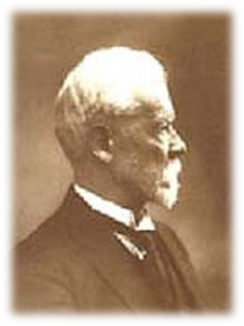
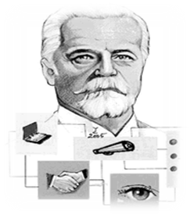
Fayol’s Principles of Management
Henri Fayol (1841-1925)
He has proposed that there are six primary functions of management and 14 principles of management, Forecasting, Planning, Organizing, Commanding, Coordinating, controlling
There are 14 Principles of Management described by Henri Fayol.

Slide 4


1. Division of Work
14 Principles of Henri Fayol
Work of all kinds must be divided & subdivided and allotted to various persons. according to their expertise in a particular area.
2. Authority & responsibility are related
Authority refers to the right of superiors to get exactness from their sub-ordinates.
Responsibility means obligation for the performance of the job assigned.
Note that responsibility arises wherever authority is exercised

Slide 5


4. Unity of Direction
14 Principles of Henri Fayol Cont’d
3. Unity of Command
A sub-ordinate should receive orders and be accountable to one and only one boss at a time. He should not receive instructions from more than one person .
People engaged in the same kind of business or same kind of activities must have the same objectives in a single plan(one head & one plan). Without unity of direction, unity of action cannot be achieved.

Slide 6



5. Equity
14 Principles of Henri Fayol Cont’d
Equity means combination of fairness, kindness & justice. The employees should be treated with kindness & equity if devotion is expected of them.
6. Order
This principle is concerned with proper & systematic arrangement of things and people.
Arrangement of things is called material order and placement of people is called social order.

Slide 7


7. Discipline
14 Principles of Henri Fayol Cont’d
Discipline means sincerity, obedience, respect of authority & observance of rules and regulations of the enterprise. Subordinate should respect their superiors and obey their order.
8. Initiative
Initiative means eagerness to initiate actions without being asked to do so. Manager must create an environment which encourages their subordinates to take initiative and responsibility.

Slide 8


9. Remuneration
14 Principles of Henri Fayol Cont’d
Remuneration to be paid to the workers should be fair, reasonable, satisfactory & rewarding of the efforts.
It should accord satisfaction to both employer and the employees.
10. Stability of Tenure of personnel
Employees should not be moved frequently from one job position to another i.e. the period of service in a job should be fixed.

Slide 9
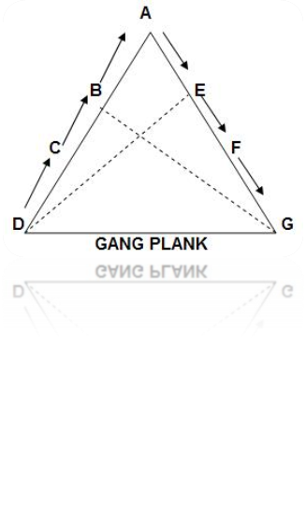

11. Scalar Chain of command
14 Principles of Henri Fayol Cont’d
Scalar chain is the chain of superiors ranging from the ultimate authority to the lowest. Communications should follow this chain. However, if following the chain creates delays, cross-communications can be allowed if agreed to by all parties and superiors are kept informed.
12. Sub-ordination of Individual Interest to general interest
An organization is much bigger than the individual it constitutes therefore interest of the undertaking should prevail in all circumstances. The interests of any one employee or group of employees should not take precedence over the interests of the organization as a whole.

Slide 10


13. Espirit De’ Corps
14 Principles of Henri Fayol Cont’d
It refers to team spirit i.e. harmony in the work groups and mutual understanding among the members. Espirit De’ Corps inspires workers to work harder.
14. Centralization
Centralization refers to the degree to which subordinates are involved in decision making. Whether decision making is centralized (to management) or decentralized (to subordinates) is a question of proper proportion. The task is to find the optimum degree of centralization for each situation.

